Slide 1

FreGS : 3D Gaussian Splatting with Progressive Frequency Regularization
Computer Vision
By-
Sai Joshika Gummireddy
Hema Sree Munagapati
Pranitha PADALA

Slide 2
Overview
Introduction
PROBLEM STATEMENT
3D-GS Vs FreGS Vs GT3
Frequency Domain
How FreGS works: step by step
Methodology
Results : visual and quantitative
Ablation study
Summary

Slide 3




Introduction
Novel View Synthesis
NerFs
The process of generating new viewpoints of a scene using a limited set of input images
an AI-based technique that generates photorealistic 3D scenes from 2D images by learning how light interacts in a scene.
3D Guassian Splatting
FreGS
3D-GS represents a scene using a collection of 3D Gaussians.
Each Gaussian is an anisotropic ellipsoid with properties like position, size, color, and opacity
Uses frequency-based filtering to add Gaussians only where needed, making the image sharper.

Slide 4
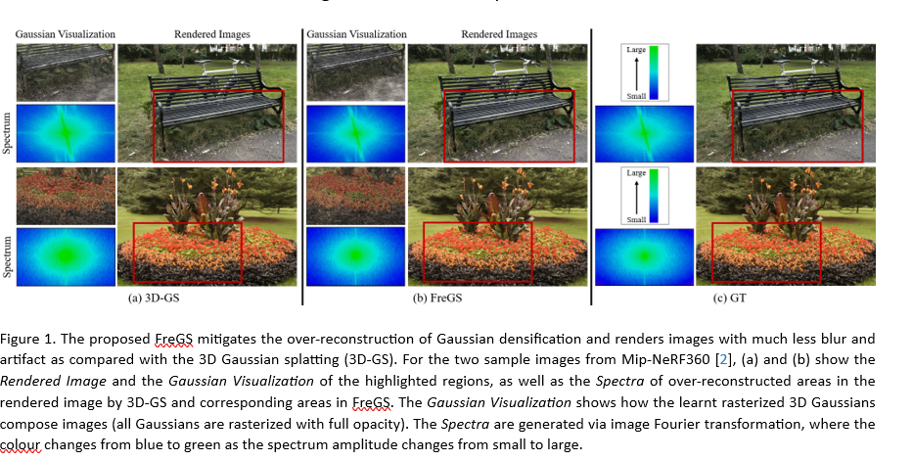
3D-GS Vs FreGS Vs GT3

Slide 5
Problem Statement
Over-Reconstruction in 3D-GS
3D Gaussian splatting (3D-GS) suffers from over-reconstruction, leading to blurry results.
High-variance image regions are often represented by fewer, larger Gaussians.
The lack of fine-grained Gaussian densification results in poor scene representation.
Requires a method to regulate Gaussian densification and enhance reconstruction quality.

Slide 6
Frequency Domain
Images can be analyzed in the spatial domain (pixels) or the frequency domain.
The frequency domain decomposes an image into its constituent frequencies.
Low frequency:
The basic shape and structure of the image.
High frequency:
The fine details, like edges, textures, and small objects.
FreGS works by making sure that both the basic shape and the fine details are accurately captured in the 3D image.

Slide 7
Key Contributions
Introducing FreGS to Solve Over-Reconstruction Using Frequency Regularization
Frequency Annealing for Progressive Frequency Regularization
FreGS Outperforms Standard 3D Gaussian Splatting (3D-GS)
Problem:
Over-reconstruction
blurry or redundant
Solution:
Controls the number of Gaussians.
It ensures that only necessary Gaussians are used, reducing redundancy while maintaining detail
Frequency annealing means gradually increasing detail levels
FreGS employs progressive frequency regularization.
Instead of regularizing all frequencies at once, it starts with low frequencies and gradually incorporates high frequencies.
Prevents early-stage noise
The researchers tested FreGS on multiple benchmarks (standard datasets used for comparison).
The results show that FreGS produces better novel view synthesis than regular 3D-GS.

Slide 8
Methodology :
Frequency Regularization
Frequency Annealing
Uses Fourier transform to analyze frequency components of rendered images.
Regularizes amplitude and phase discrepancies between the rendered image and ground truth.
Prevents over-reconstruction by aligning frequency spectra of rendered images with real scenes.
Enhances Gaussian densification by reducing high- frequency artifacts.
Low-pass filters initially focus on capturing global structures.
High-pass filters progressively refine details, enabling fine Gaussian densification.
Leads to improved reconstruction quality with fewer artifacts.
Progressive frequency regularization applied during training.

Slide 9
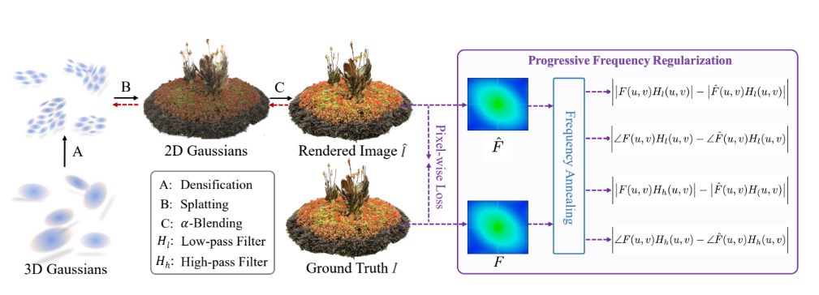
Implementation Step-by-Step:
Step 1: Data Collection (Structure-from-Motion)
Capture multiple images of a scene from different viewpoints.
Step 2: Convert 3D Points to Gaussians
Represent each 3D point as a 3D Gaussian with: Position (mean), Shape (covariance), Opacity (visibility)
Step 3: Gaussian Splatting for 2D Rendering
Project 3D Gaussians onto a 2D image plane.
Step 4: Frequency Analysis (Fourier Transform)
Convert rendered image and ground truth into frequency space.
Step 5: Compute Amplitude & Phase Discrepancies
Identify errors in frequency components that cause. over-reconstruction
Step 6: Progressive Frequency Regularization
Prevents over-reconstruction by guiding Gaussian densification.
Step 7: Optimize Gaussian Densification
Step 8: Final Rendering & Novel View Synthesis

Slide 10
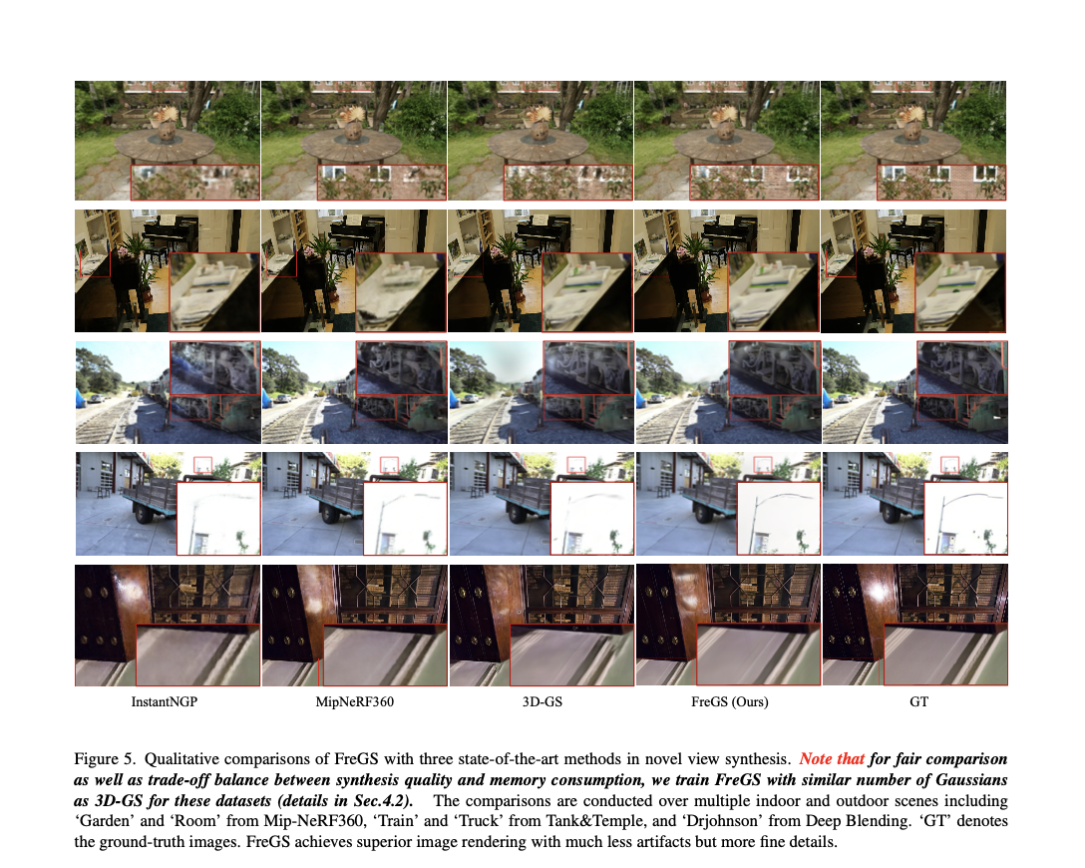
Results - Visual
FreGS reduces blur and sharpens details in rendered images.
It achieves visually superior results compared to 3D-GS and other methods.
The improvement is particularly noticeable in high-frequency regions with fine details.
Visual comparison of rendered images: FreGS (right) produces sharper and more detailed images compared to 3D-GS (left).

Slide 11
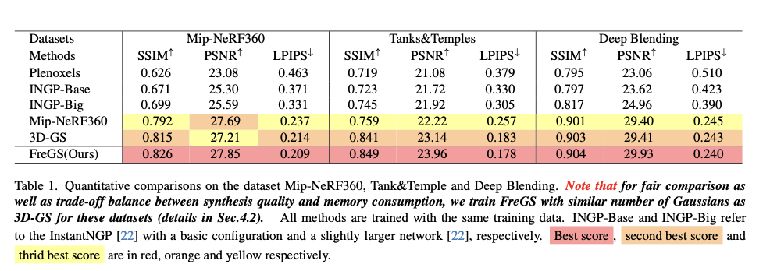
Results - Quantitative
FreGS outperforms 3D-GS and other methods in quantitative metrics.
Metrics used include PSNR (peak signal-to-noise ratio), SSIM (structural similarity index measure), and LPIPS (learned perceptual image patch similarity).
These metrics measure the quality of the rendered images in terms of pixel-level accuracy, structural similarity, and perceptual similarity, respectively.
Quantitative results: FreGS achieves higher scores in PSNR, SSIM, and LPIPS, indicating improved image quality

Slide 12
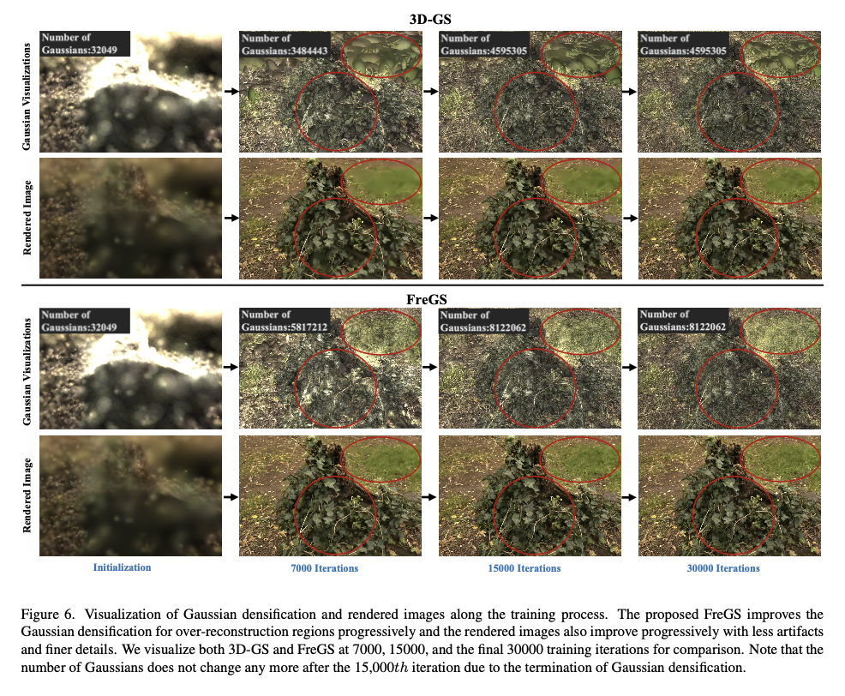
Improved Gaussian Densification
FreGS improves the Gaussian densification process.
By addressing over-reconstruction, FreGS leads to a more effective and accurate representation of the scene using Gaussians.
This results in better rendering quality and reduced artifacts.

Slide 13
Ablation Study
Ablation studies were conducted to evaluate the contribution of different components of FreGS.
The results demonstrate that both frequency regularization and frequency annealing are important for the effectiveness of FreGS.
Removing either component leads to a decrease in performance.

Slide 14
Summary
FreGS is a novel 3D Gaussian Splatting framework that addresses the over-reconstruction issue.
It introduces progressive frequency regularization with frequency annealing.
FreGS achieves superior novel view synthesis and outperforms state-of-the-art methods.

Slide 15
Thank You

